Slide 1
OSINT
Maciej Szwoch
UIC Cyber Sig
9-6-2022

Slide 2

Agenda
Overview
Search Engines
Web App
Cool Stuff

Slide 3
Caution:
Using OSINT to do things such as stalk people / organizations that did not give you their explicit consent is not supported by the LUG, ACM, or UIC.
The LUG, ACM, and UIC take 0 responsibility for any repercussions
Use common sense.
Consequences may include expulsion, legal lawsuits, restraining orders etc…
Please use these tools responsibly, and ethically.

Slide 4
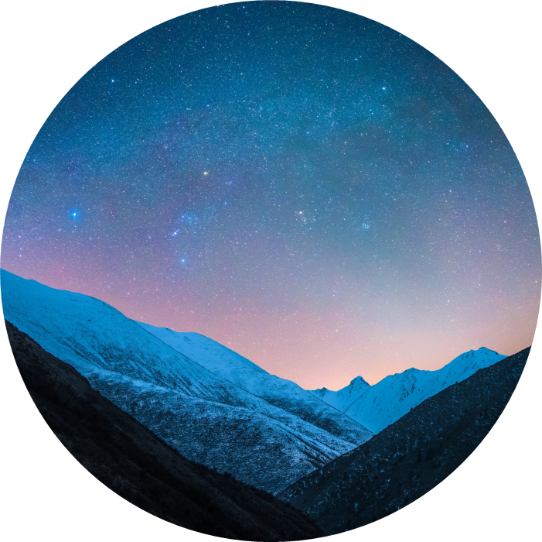
What is OSINT?
Open-source Intelligence
This type of information gathering is virtually undetectable as all the information is available online to the public
Note: Some of the tools listed use techniques that are more effective but also leave a footprint. Know the tools you are using and how they work before using them.

Slide 5
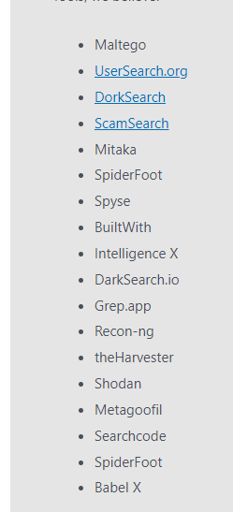
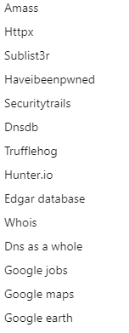
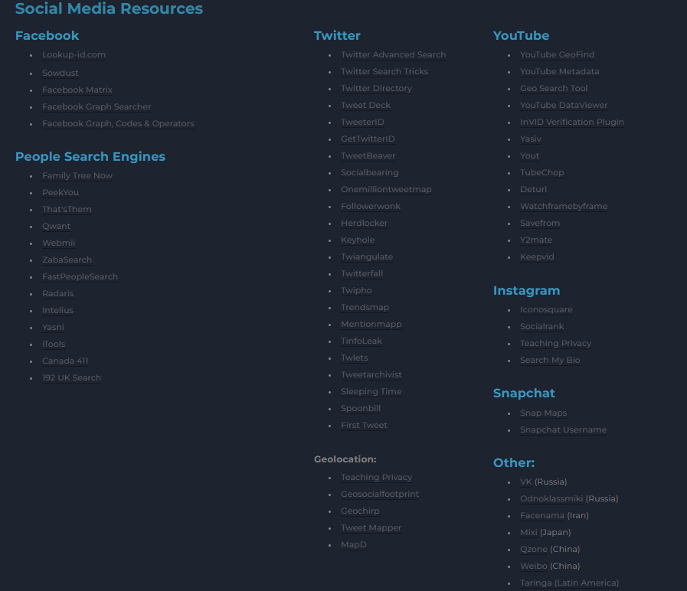
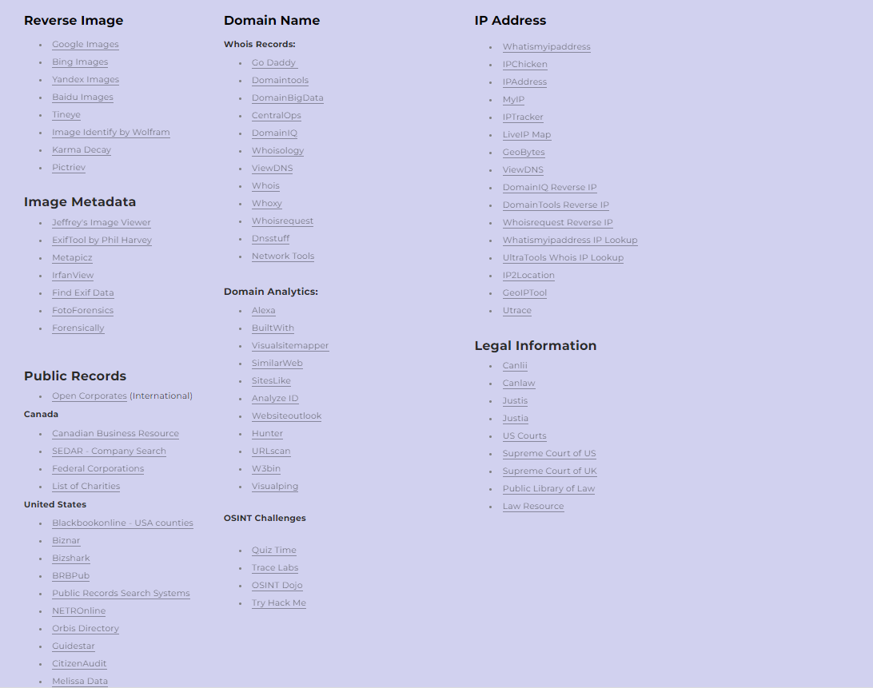
Too many tools
Here is just a small sample of tools that are commonly used… (Notice how there’s so many that you can’t read half of them)

Slide 6
And many more…
The amount of OSINT tools out there is way to much for anyone to cover
If you are ever searching for a tool, try this website
https://www.osinttechniques.com/osint-tools.html
The good ones, tend to cost $$$

Slide 7
Search Engines
Inurl:”google”

Slide 8
Search Engines
Everyone knows Google, but what about…
Bing (Not a joke)
Yandex
TinEye
DuckDuckGo

Slide 9
Google Power
Everyone knows Google Dorks, but are you using Google to its full potential?
-Some dorks are depreciated, and do not work as intended
Here are some basics… (Don’t write these down, just google, google dorks…)

Slide 10
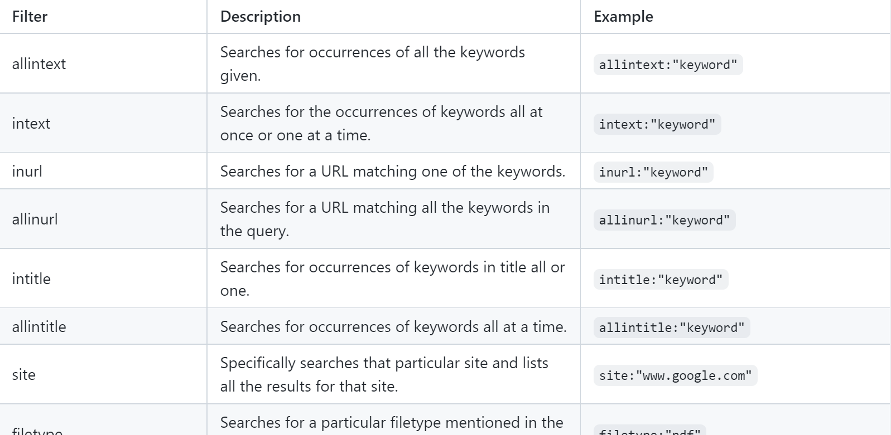
Dorks
My favorite dork is <textbook> AND filetype:pdf

Slide 11
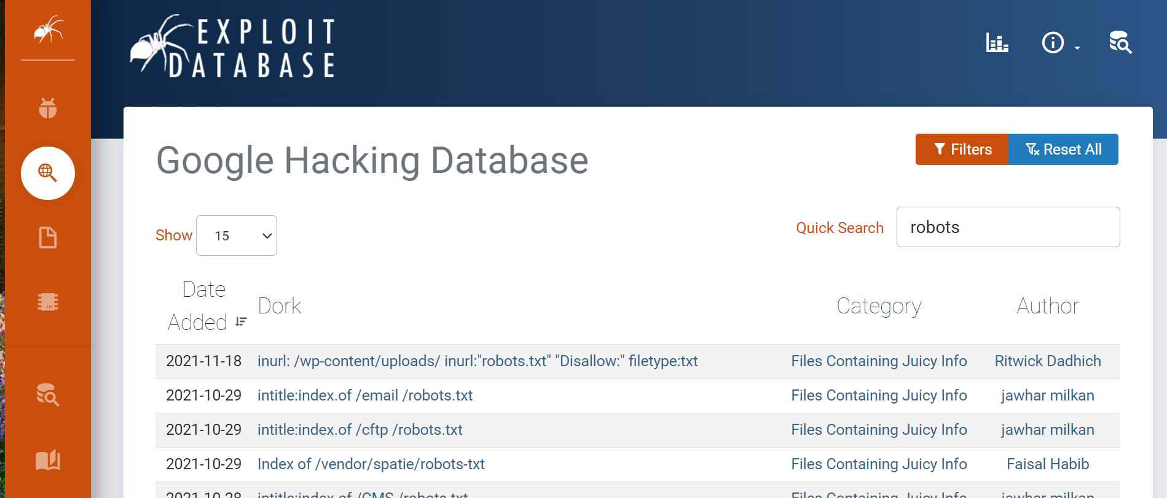
Google ExploitDB
This is where Google’s True Power is revealed…
https://www.exploit-db.com/google-hacking-database

Slide 12

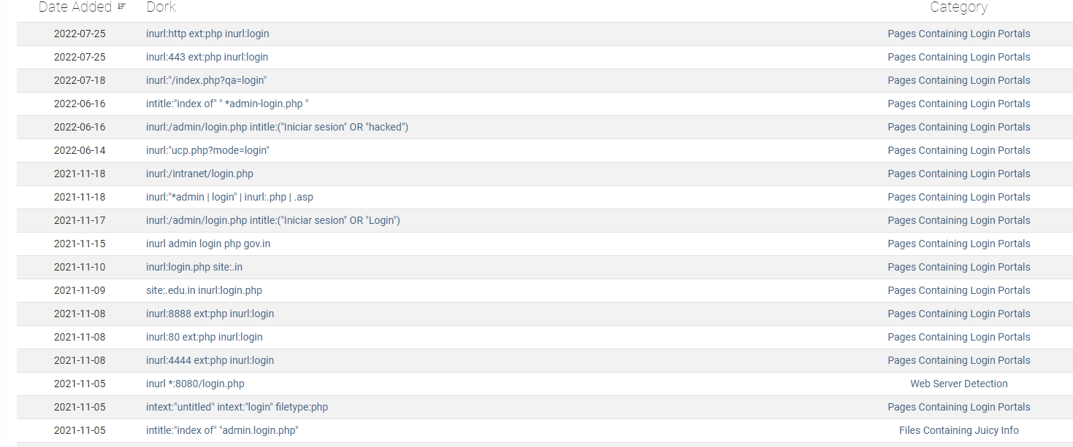
Google HDB USe
Find out if there is a php login for a target.
There are many php dorks to try, you may want to try a few...

Slide 13
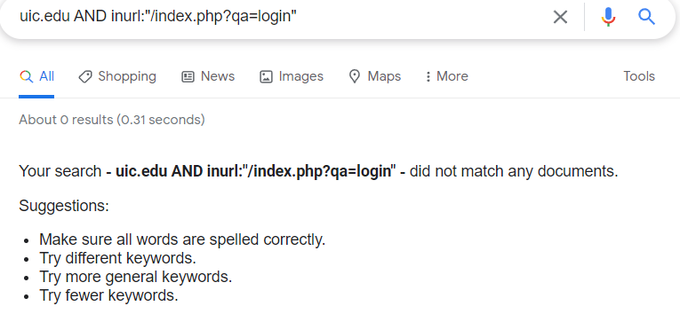
Google HDB USE
This doesn’t imply that UIC doesn’t have a login, only that this specific query does not have results.
Try using other Dorks

Slide 14
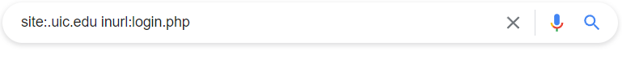
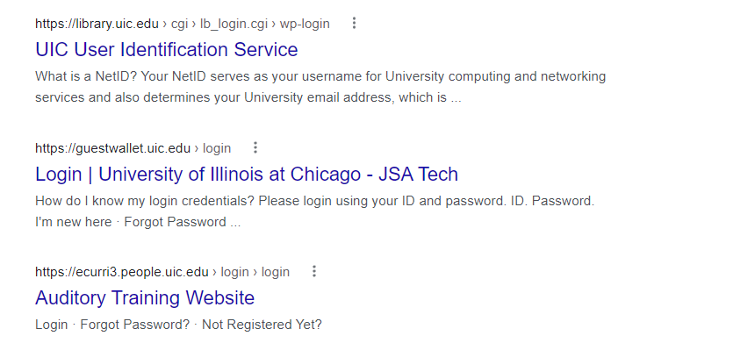
Google HDB USE
That last search didn’t work, lets see if we can try another DORK

Slide 15
Google HDB USE
So is this a 100% confirmed php login? No.
But it is a pretty good indication
Further investigation is needed

Slide 16
Web App Technologies
Whats under the hood?

Slide 17
Some Tools
We are going to analyze library.uic.edu with
-Built-with
-Ful.io
-Wappalyzer
-

Slide 18
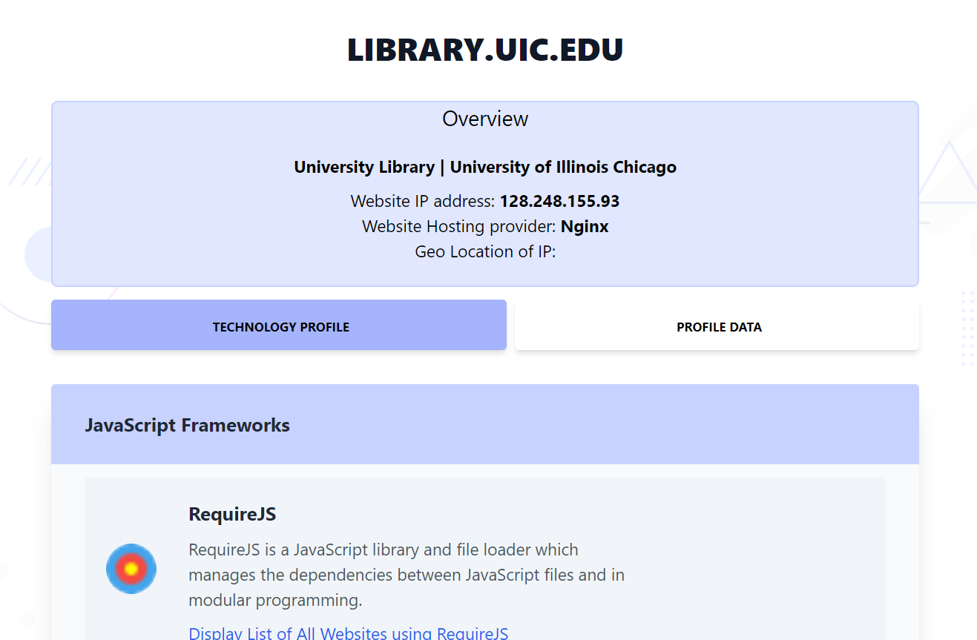
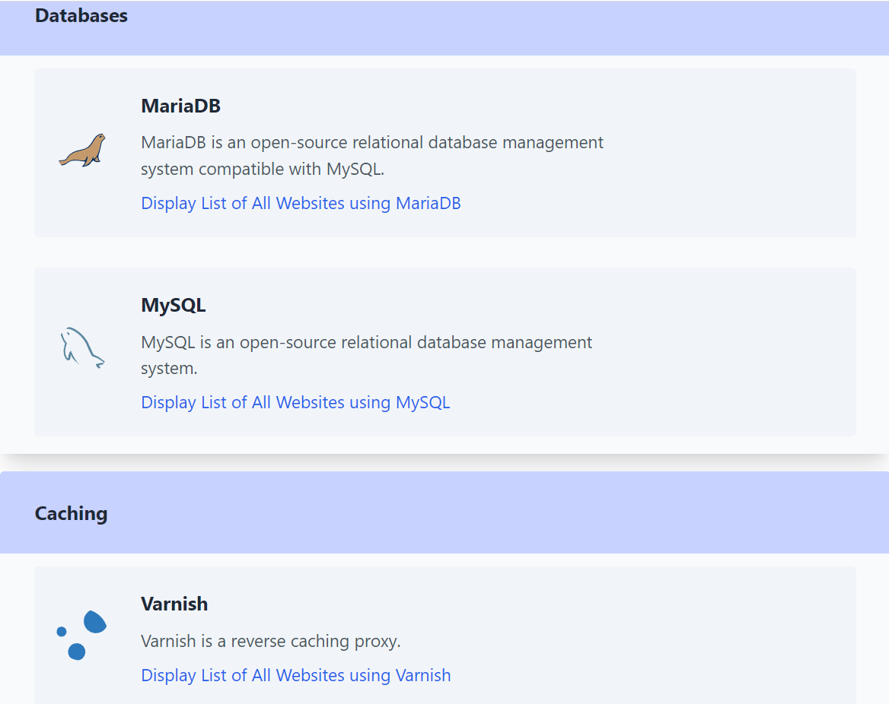
FuL.io

Slide 19
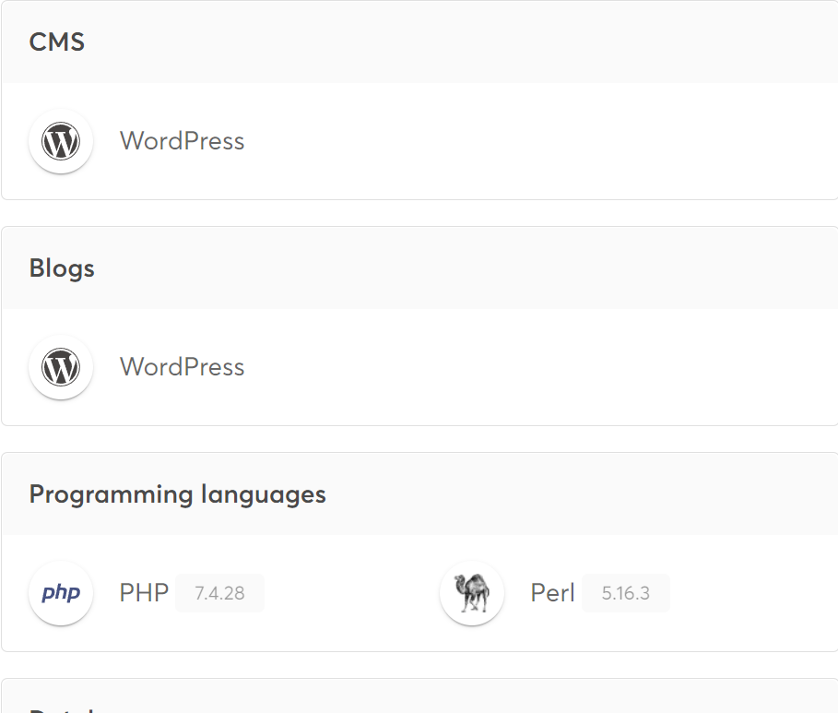
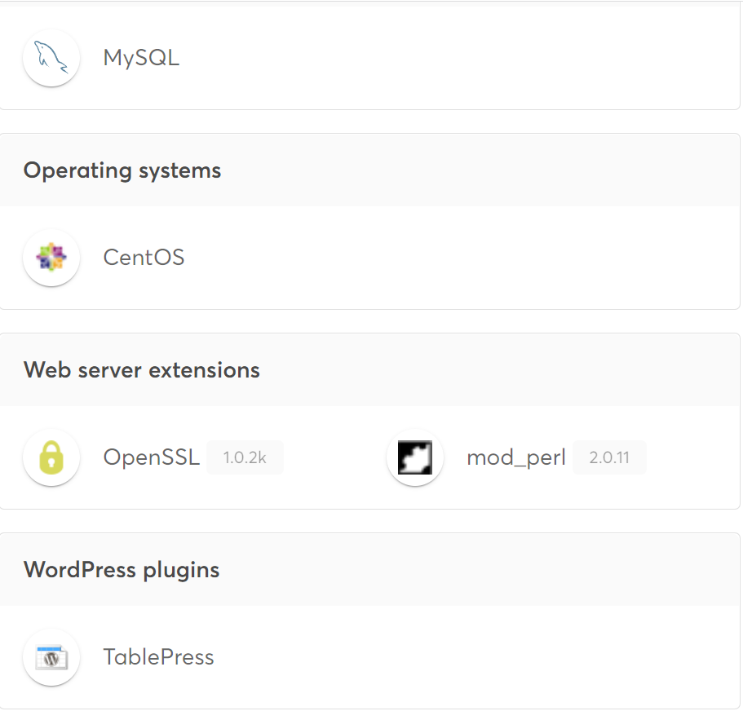
Wappalyzer

Slide 20
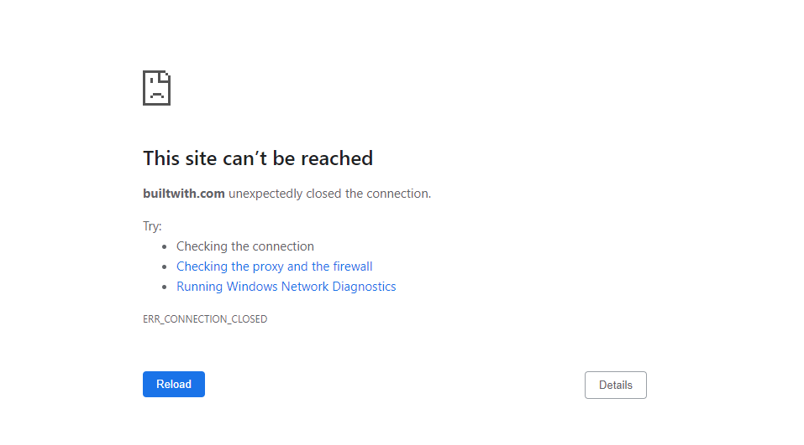
Built-with

Slide 21
Archives
Time-travel to the past

Slide 22
Archive.org
Be careful
find links to resources that aren’t easily found
Companies are a lot more careful today

Slide 23
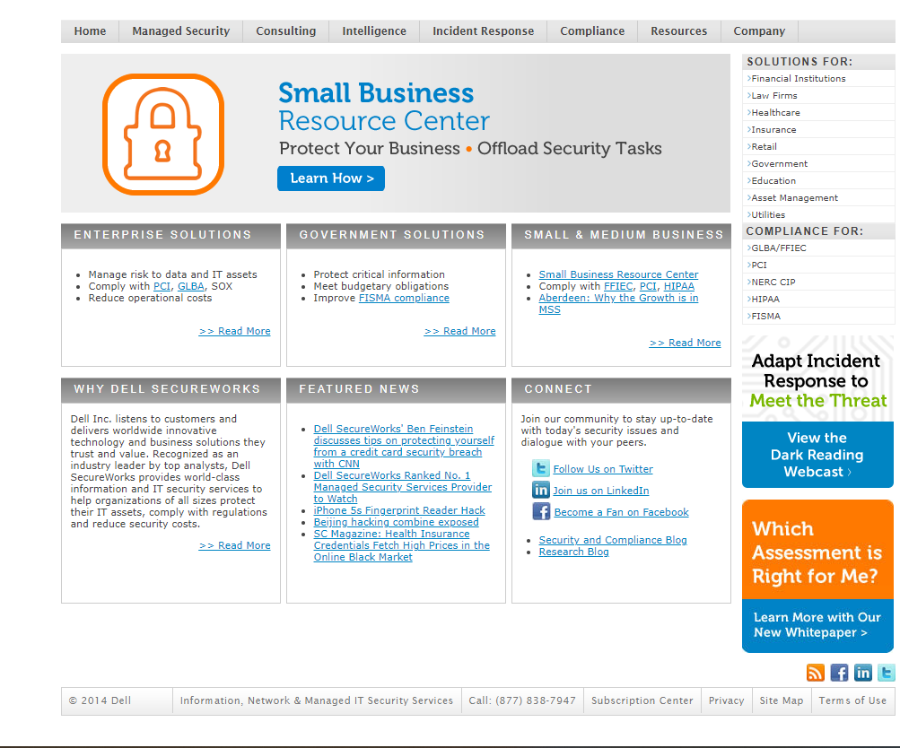
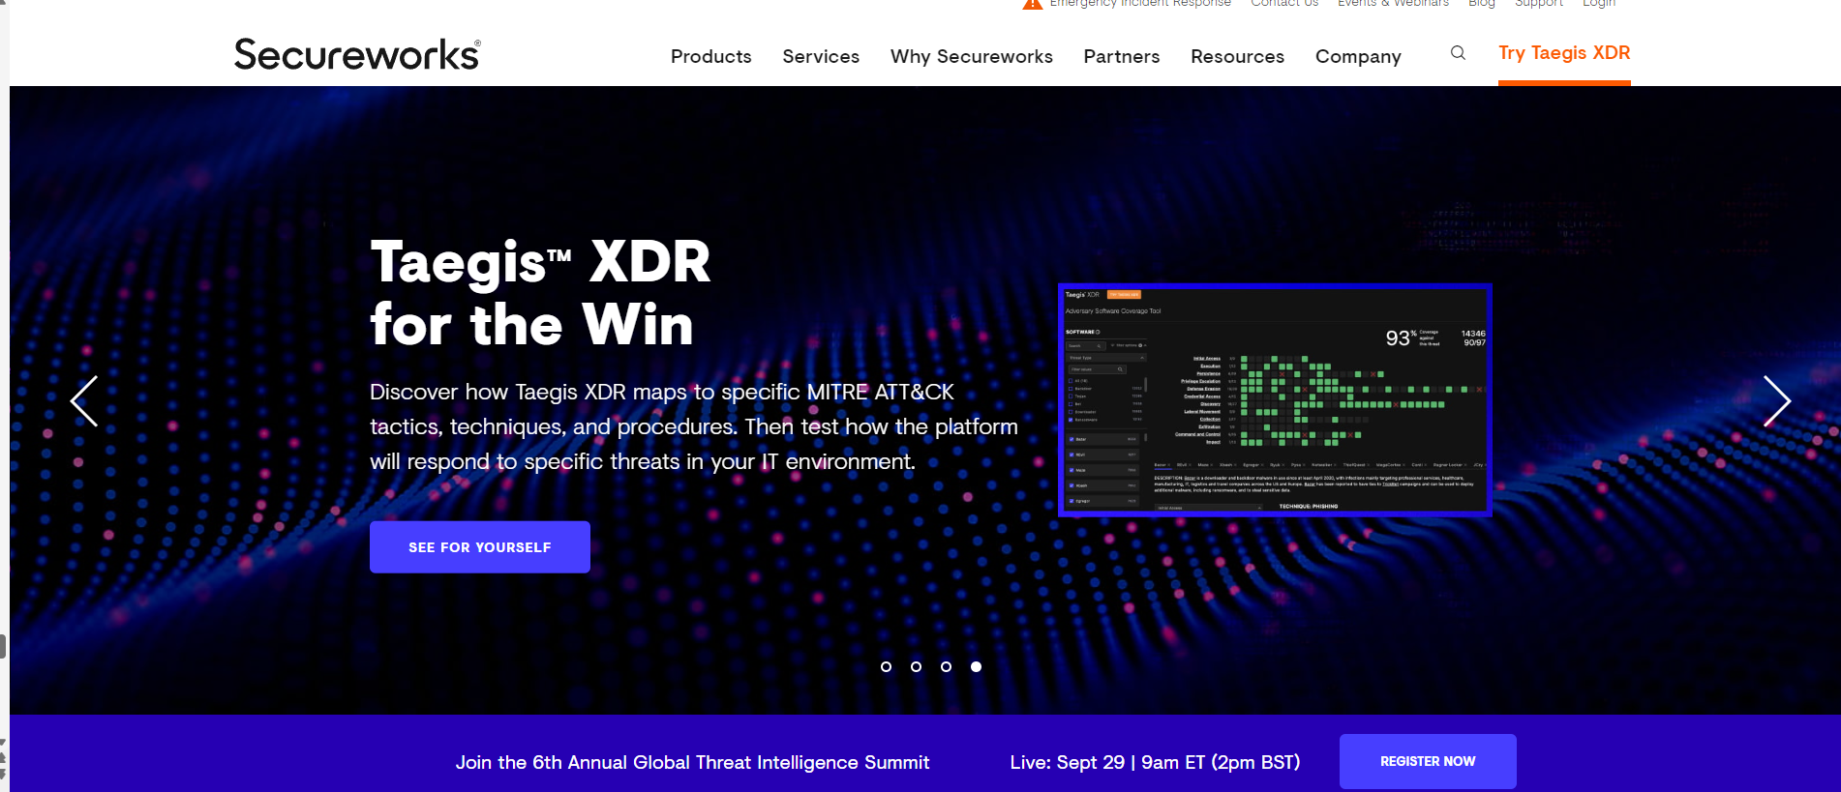
SecureWorks
2014
2021

Slide 24
Cool stuff

Slide 25
Dns
You could use your classics…
Whoami
DnsDumpster
Google
Or you could use a tool that automates it for you…
Sublist3r
Maltego

Slide 26
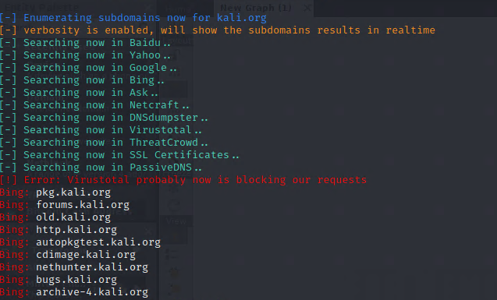
Sublist3r

Slide 27
Email Stuff
Find company emails / contact info
Linkedin
Crunchbase
Hunter.io
Emails can be used for spear phishing attempts or to find exposed credentials
Combine with google dorks!
Lets show an example with uic.edu

Slide 28
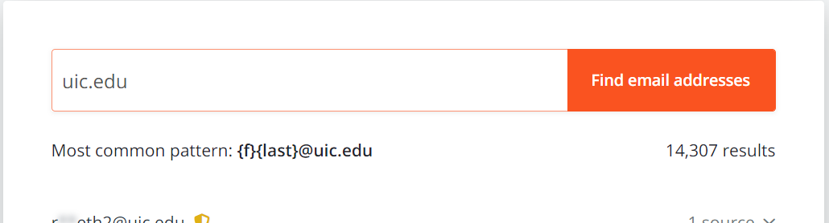
Email Stuff
According to hunter.io the usual format is {f}{last}@uic.edu

Slide 29
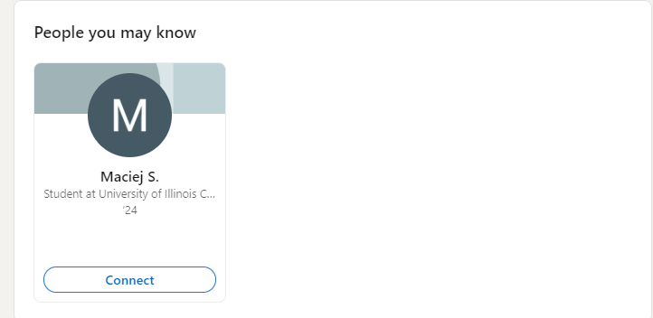
Email Stuff
Using LinkedIn we can see that our target likely has a UIC email

Slide 30
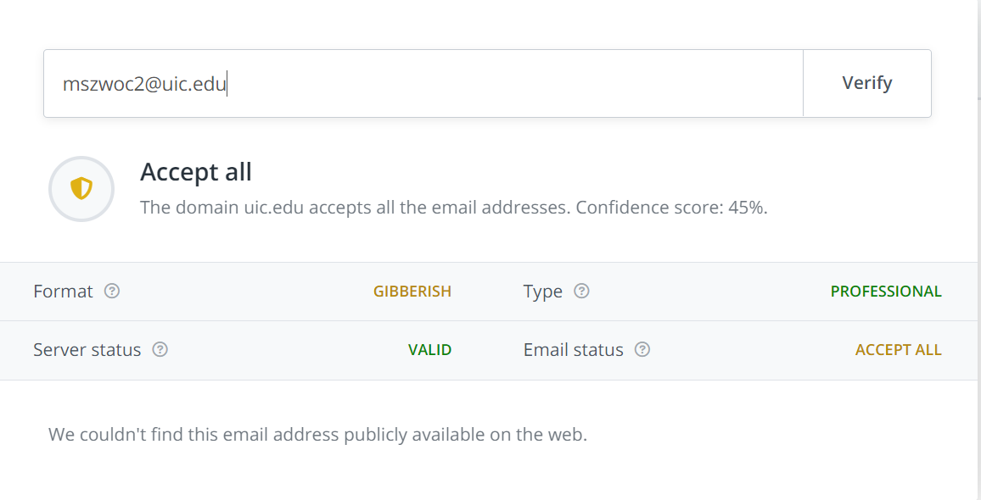
Email Stuff
Using Hunter.io we can also verify if the email is valid

Slide 31
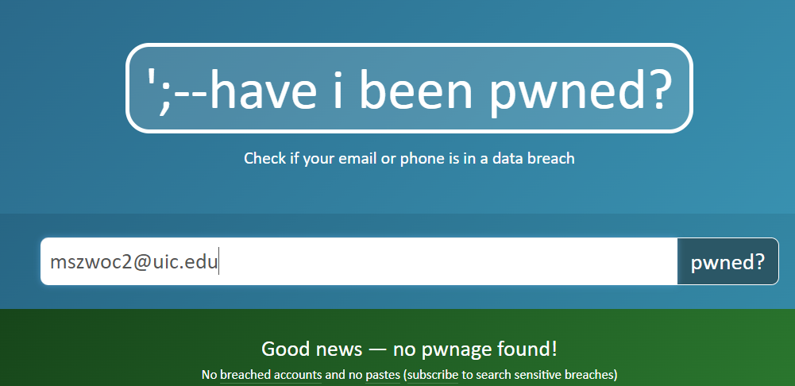
Email Stuff
Finally we can check to see if that email has been compromised (If it is, we can attempt to find old creds!)

Slide 32
Reverse Image search
AI image searching has come a long way
Don’t be weird and search other people without their permission
Tools: Google, Yandax, Tineye, and Pimeye
Pimeye is the best but also costs money

Slide 33
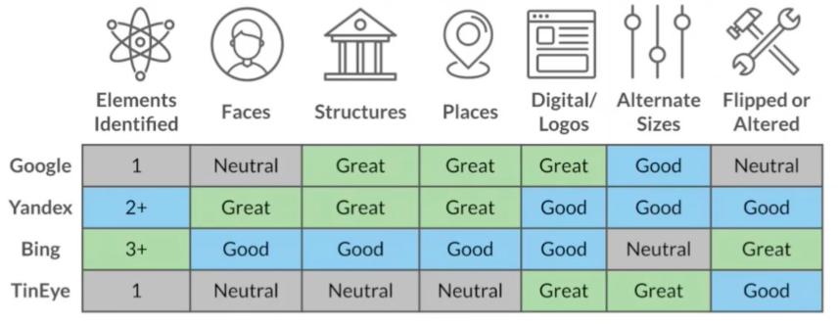
Which Search engine to use?
All of them, but here is a general break down provided by TraceLabs…

Slide 34
Pimeyes
Be aware that reverse-image searches often net NSFW results. Use at your own risk.
You often get results that are very similar to the picture but not exactly the same person
Every now and then, it works like magic…

Slide 35
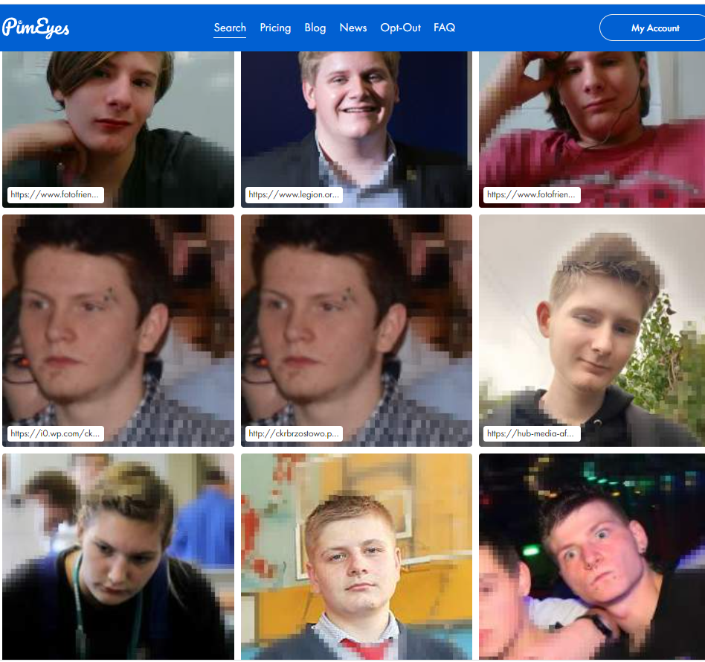
Can you Spot me?

Slide 36



Summary
There’s a lot more stuff out there to cover, but we’re already 30+ slides in, and its 11pm.
https://www.osinttechniques.com/osint-tools.html

Slide 37




Thank you
Maciej Szwoch
UIC LUG Cyber Sig

